Slide 1
Fish546-2018 bioinformatics
eDNA data analysis – final project presentation
Marta Gomez-Buckley (SAFS)

Slide 2
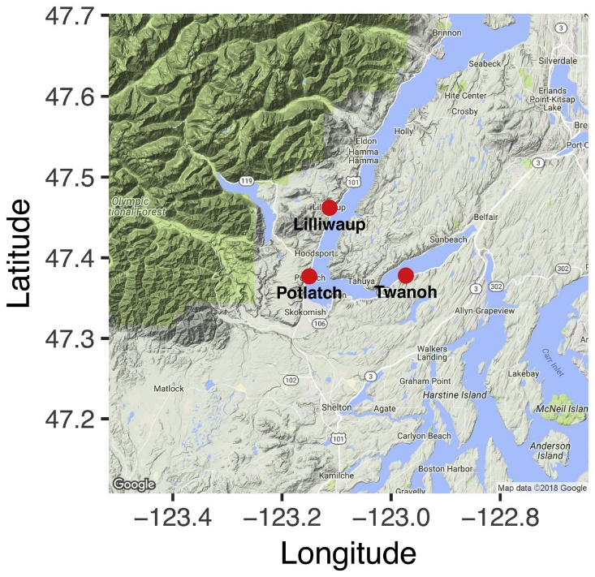
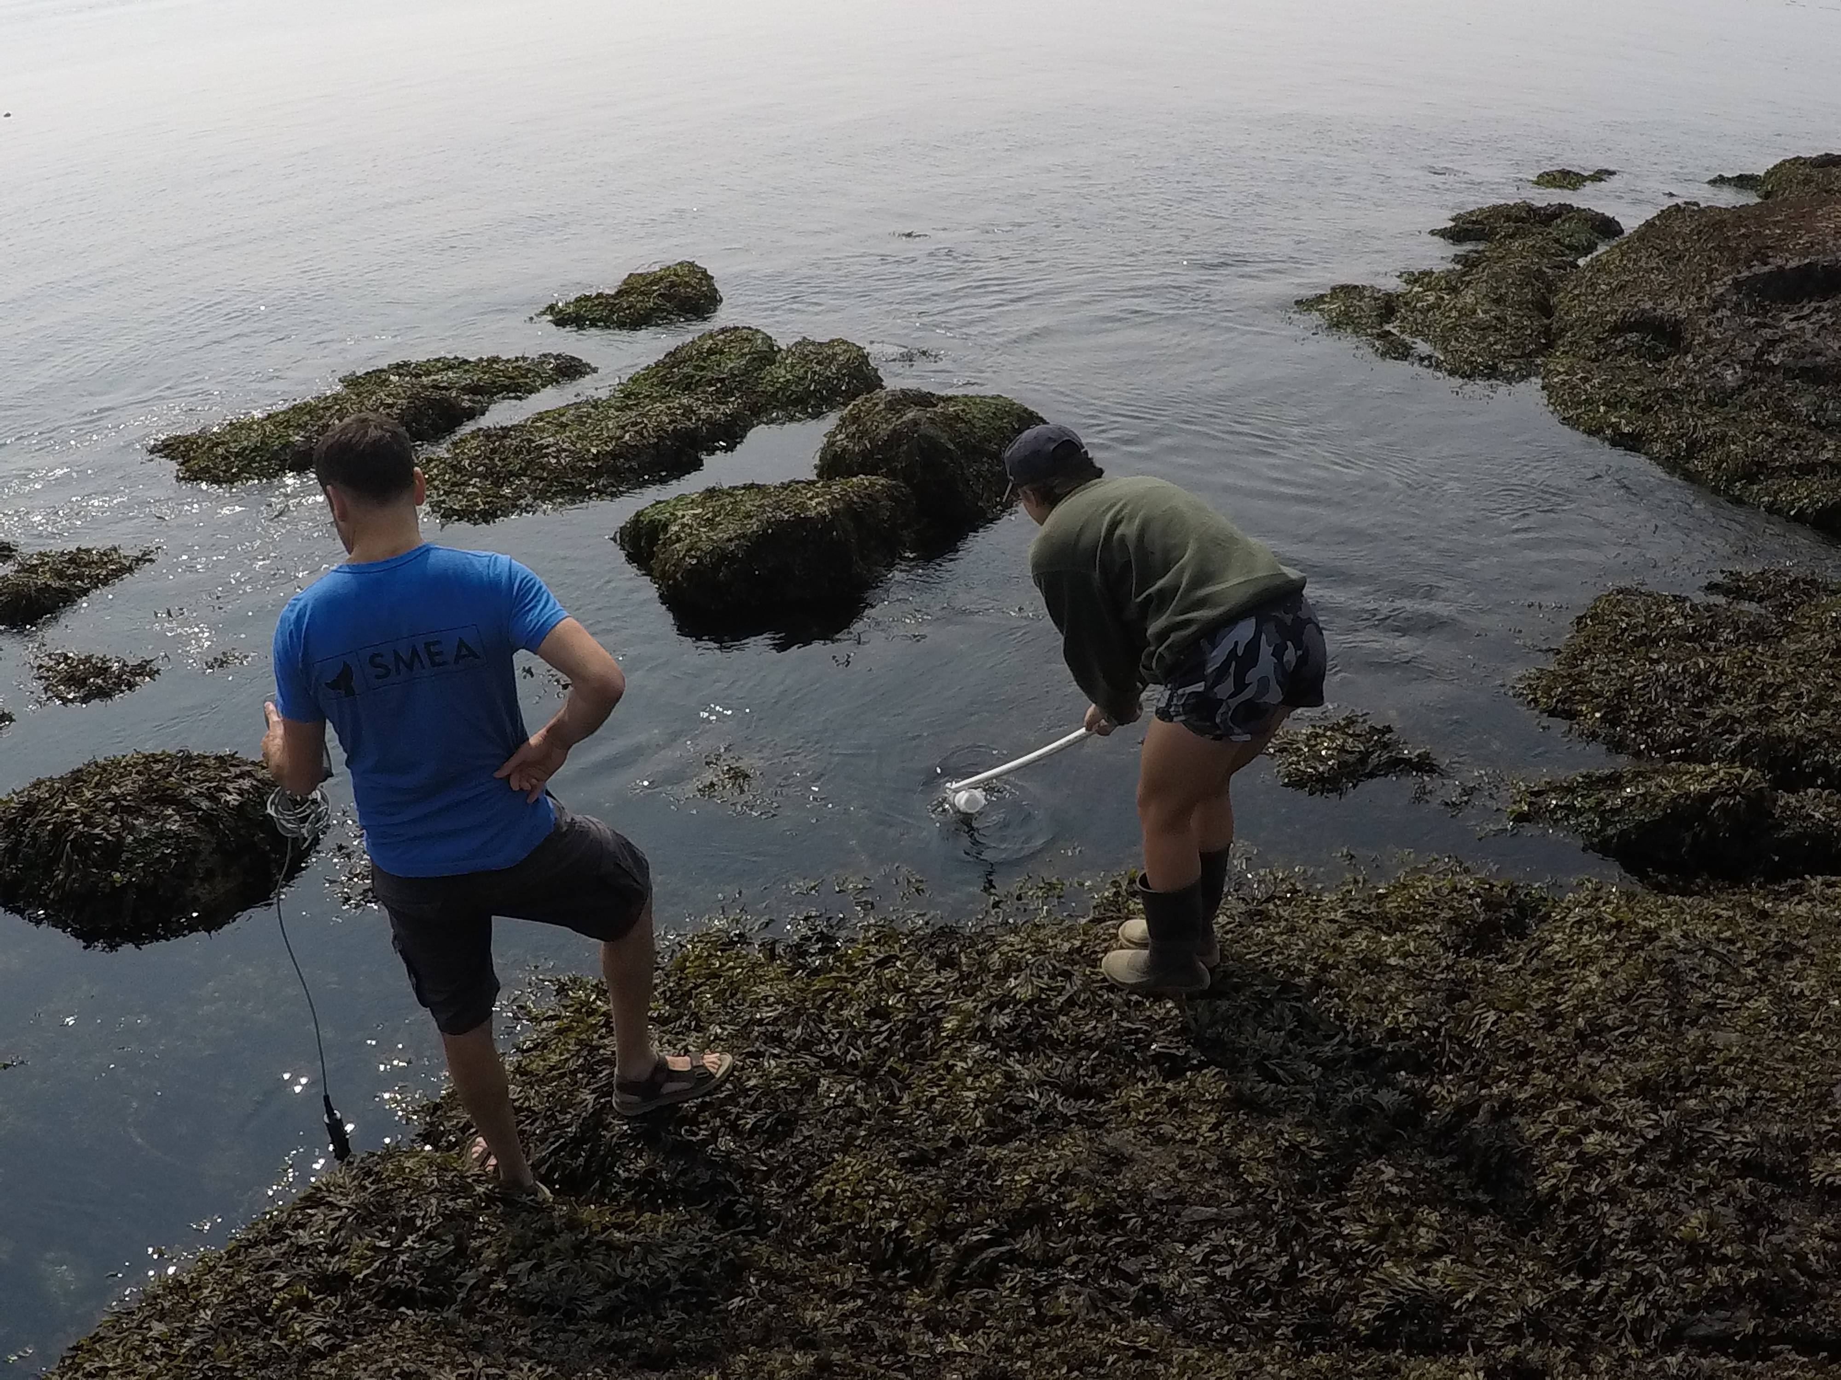
Rationale
For this project I explored the process involved in analyzing data from an already published project of eDNA samples collected at three locations in Puget Sound by UW’s SMEA team
I will be applying what I learned to analyze eDNA samples collected from my research sites in Tonga during the next four weeks!

Slide 3
My Question (What am I learning)
What bioinformatic tools are available for analysis of eDNA/metabarcoding samples?
My sub-question:
Windows vs. Mac?

Slide 4
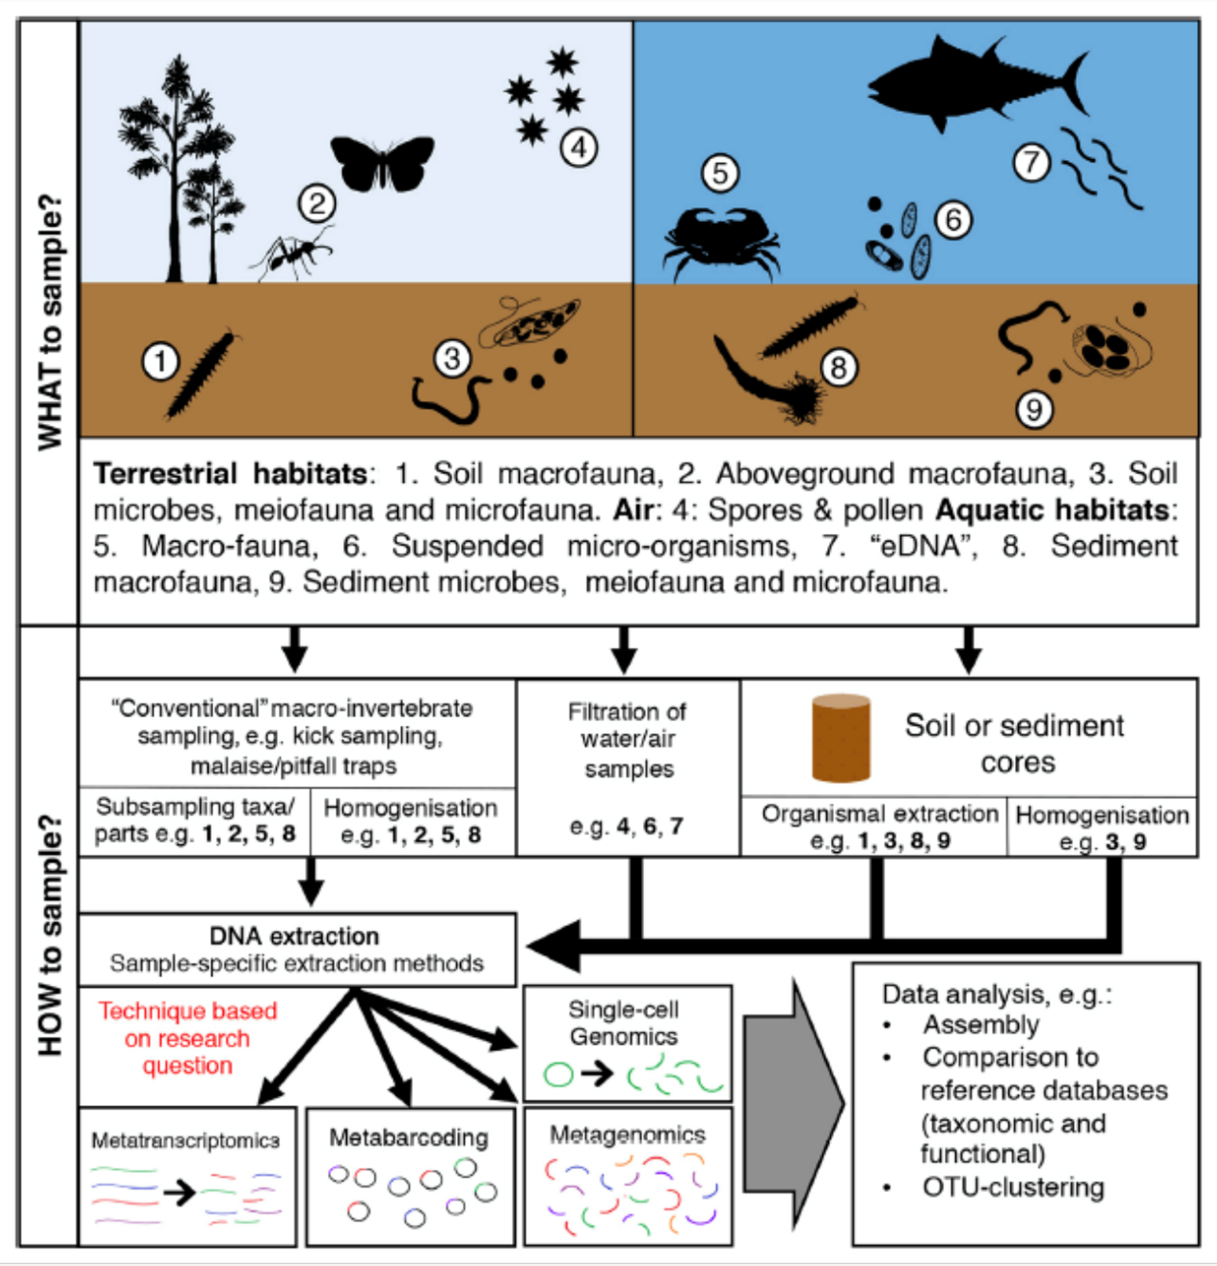
A little of the big picture

Slide 5
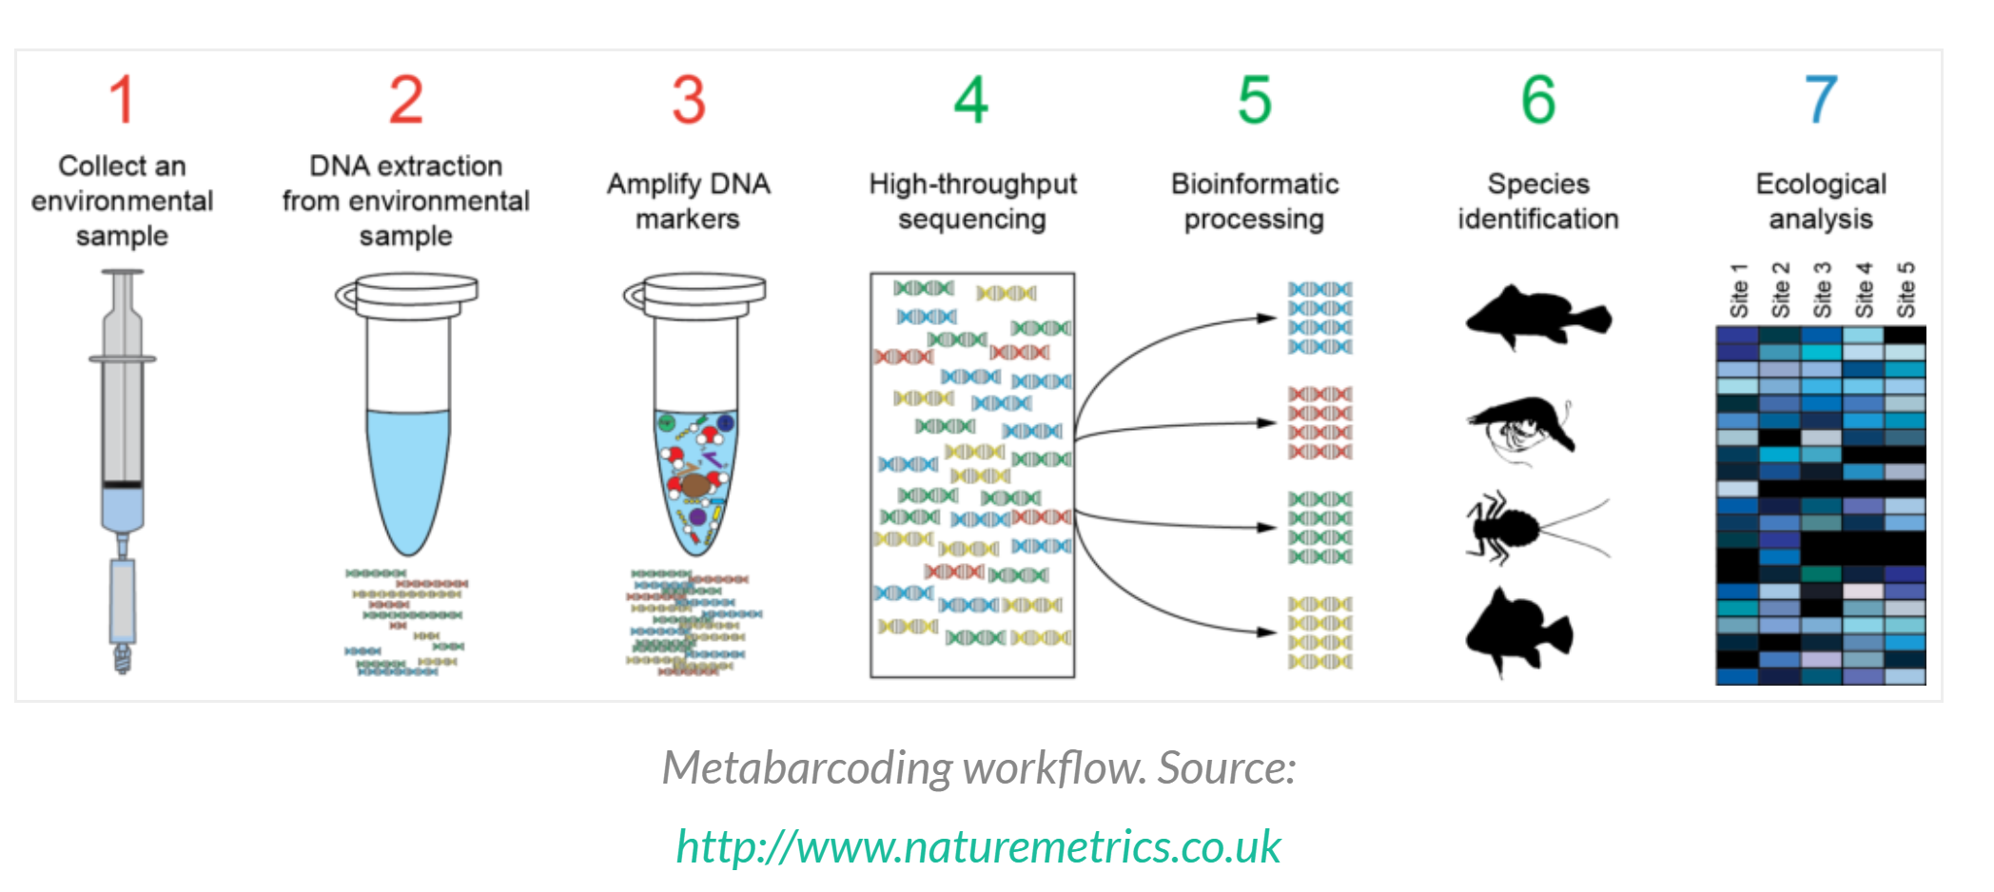
A little of the big picture

Slide 6






My bioinformatics exploration
PEAR
ORIGINAL DATA - two fastq files (one forward reads, one reverse reads)
R SCRIPT
MERGE
GENEIOUS
REMOVE adapters & primers
ONE LARGE MERGED FASTA FILE
REMINDER OF STEPS BEFORE BLASTN!!
Demultiplex

Slide 7
R script to generate merged file
install.packages("insect")
library (insect)
getwd() # which is the working directory
list.files() # what files/folders
# Load R1 and R2 files
Read.1 <- readFASTQ("Data/Good-lib2_S2_L001_R1_001.fastq")
Read.2 <- readFASTQ("Data/Good-lib2_S2_L001_R2_001.fastq")
# Load PCR primers
mlCOIintF <- "GGWACWGGWTGAACWGTWTAYCCYCC"
jgHCO2198 <- "TAIACYTCIGGRTGICCRAARAAYCA"
# Merge both pairends
Read.merged <- stitch(Read.1, Read.2, up = mlCOIintF, down = jgHCO2198, minoverlap = 50)
# write the merged file to disk
writeFASTQ(Read.merged, file = "Good-lib2_s2_merged.fastq")
# Remove low quality seqs
Read.cleaned <- qfilter (Read.merged, minqual = 30, maxambigs = 0, mincount = 2, minlength = 350, maxlength = 500)
# write the clean file to nb
writeFASTQ(Read.cleaned, file = "Good-lib2_s2_cleaned.fastq")

Slide 8
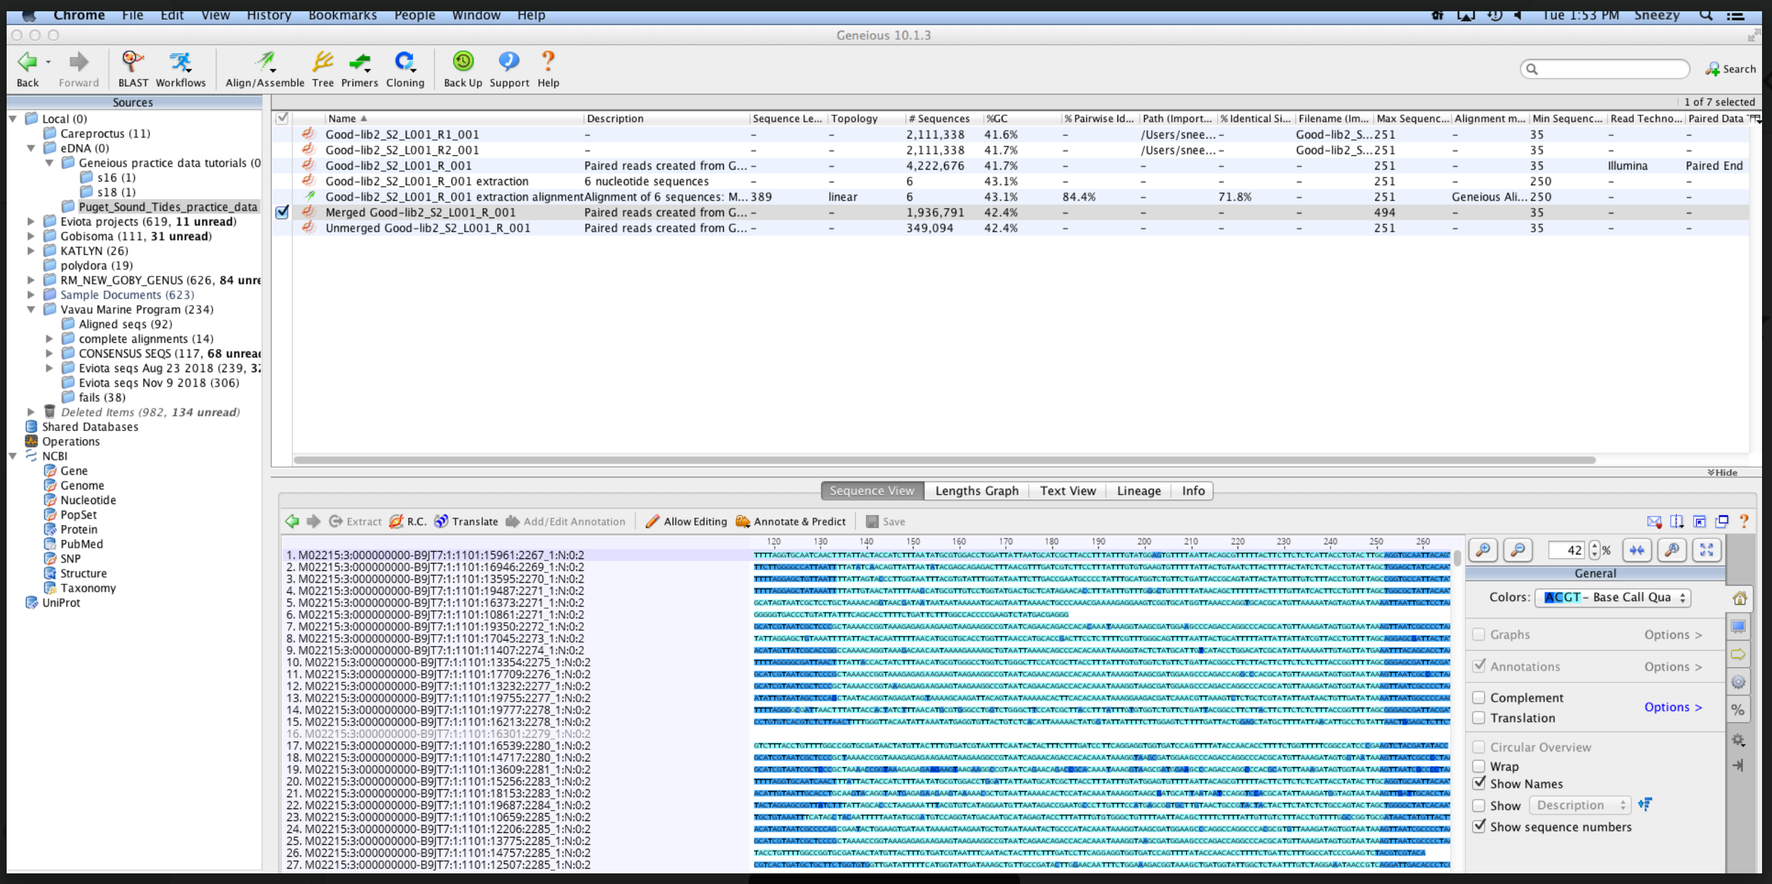
Geneious program for merging and exporting files as fasta type

Slide 9
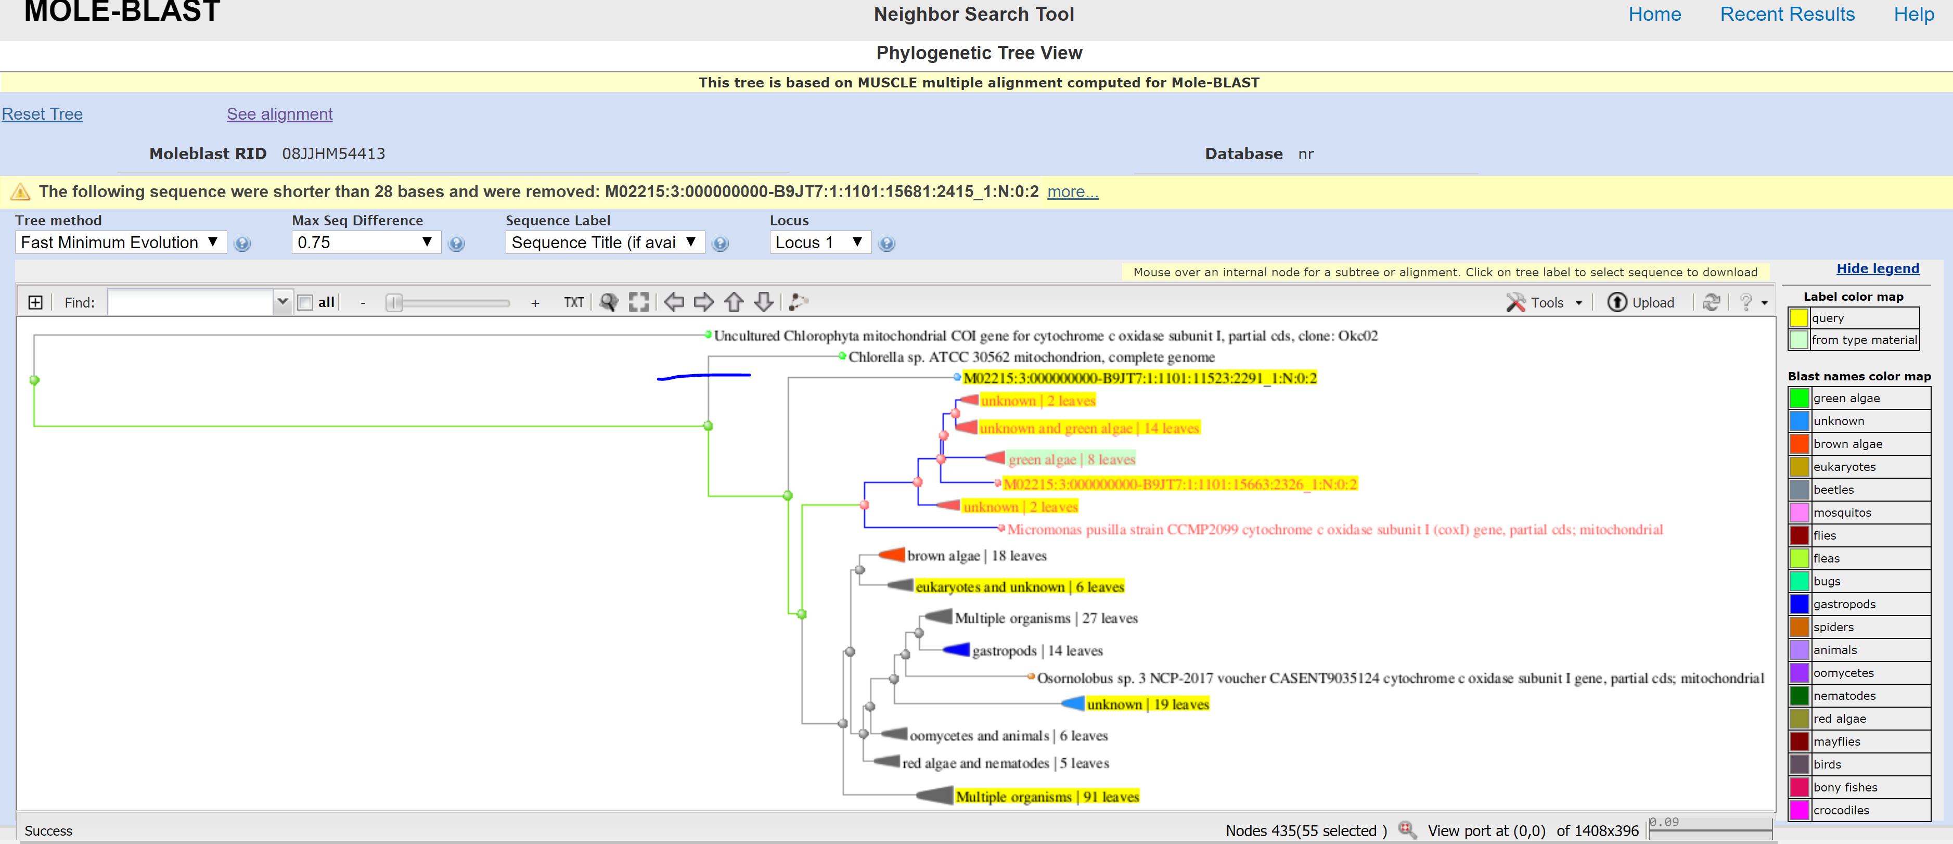
Running MOLE-BLAST on NBCI

Slide 10

Next steps
GET A MAC BOOK PRO!!!

Slide 11
Next steps
Get to reproduce the whole already designed pipeline prepared by SMEA team with my own data
Get more practice with bash commands, Jupyter Notebook, and R

Slide 12
